Slide 1
Predicting the Risk of Injury in the NFL
Eric Alonas

Slide 2
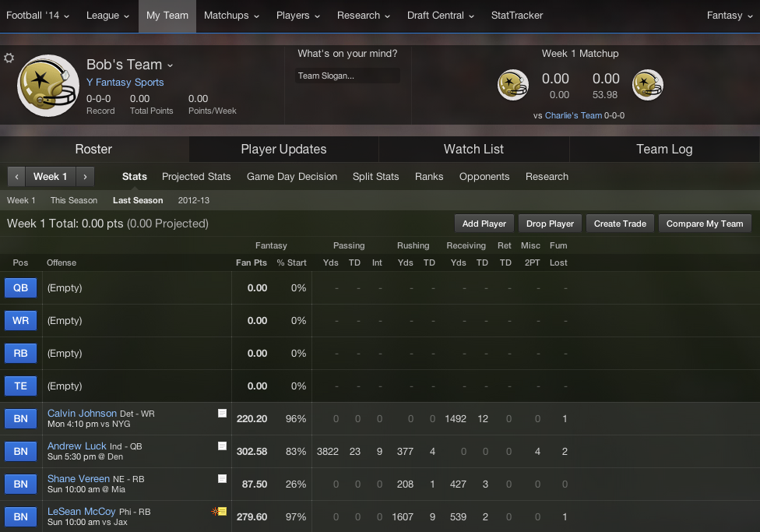

Slide 3
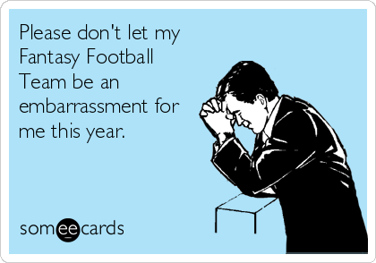

Slide 4
Problem Statement
Problem:
Starting lineup sabotaged by injuries
Can’t keep up with all the news of who’s injured and who’s not
Result: Underperforming fantasy team
Solution:
Analyze relationship between injuries and stats
Predict likelihood of injury
Stretch goal: quantify performance/injury risk ratio for entire roster

Slide 5
Factors to consider
Team
Position
Playing time
Distance covered
History of previous injuries
Type of play (run, pass, etc)

Slide 6
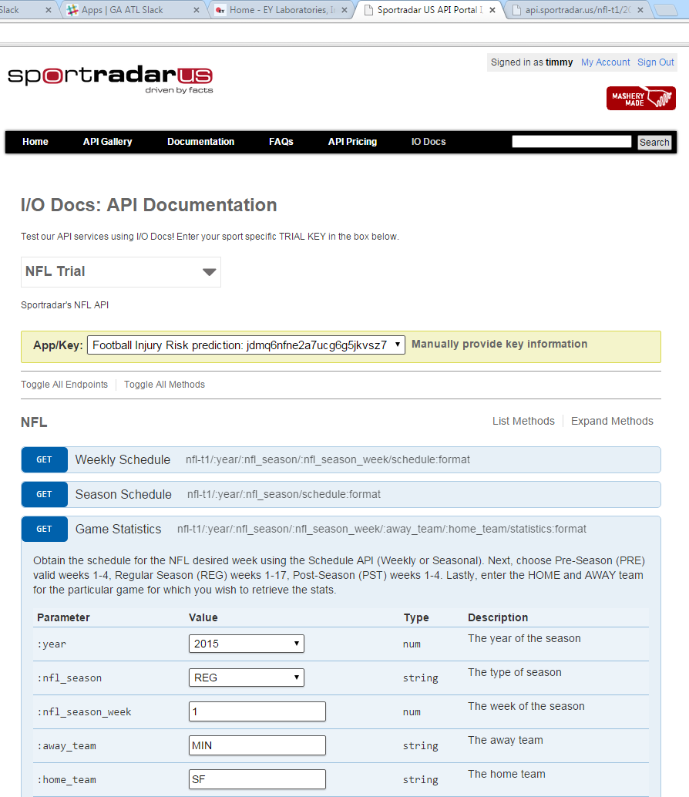
Gathering Data

Slide 7
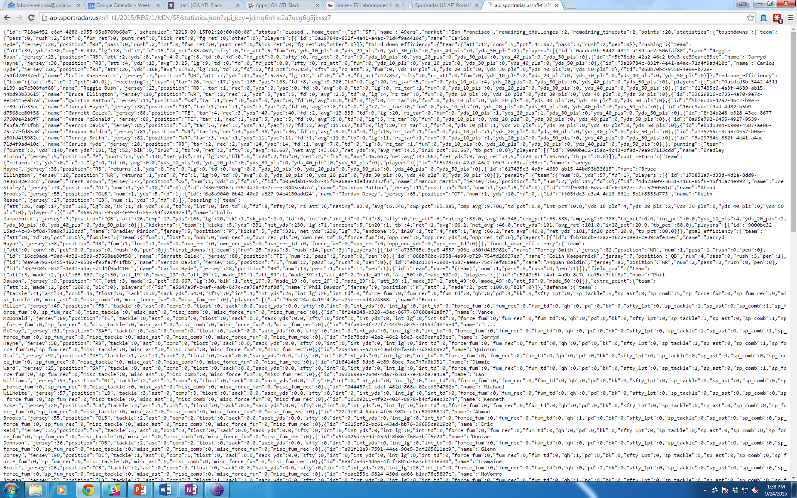
Gathering Data

Slide 8
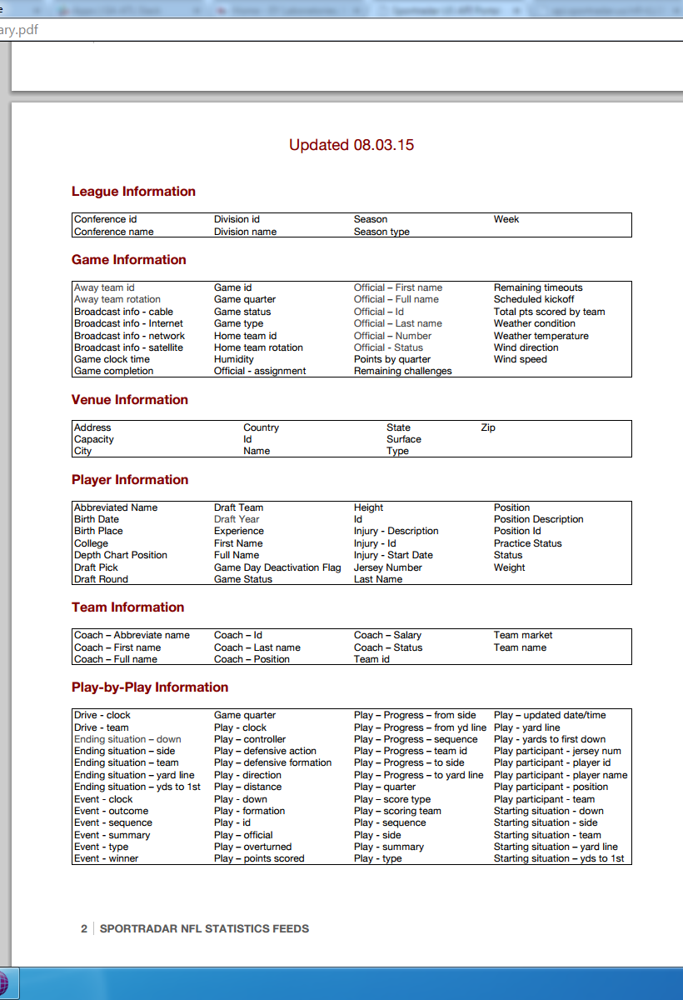
Gathering Data

